Slide 1
Built-in Functions
Chul Min Yeum
Assistant Professor
Civil and Environmental Engineering
University of Waterloo, Canada
AE121: Computational Method
Last updated: 2019-05-28

Slide 2
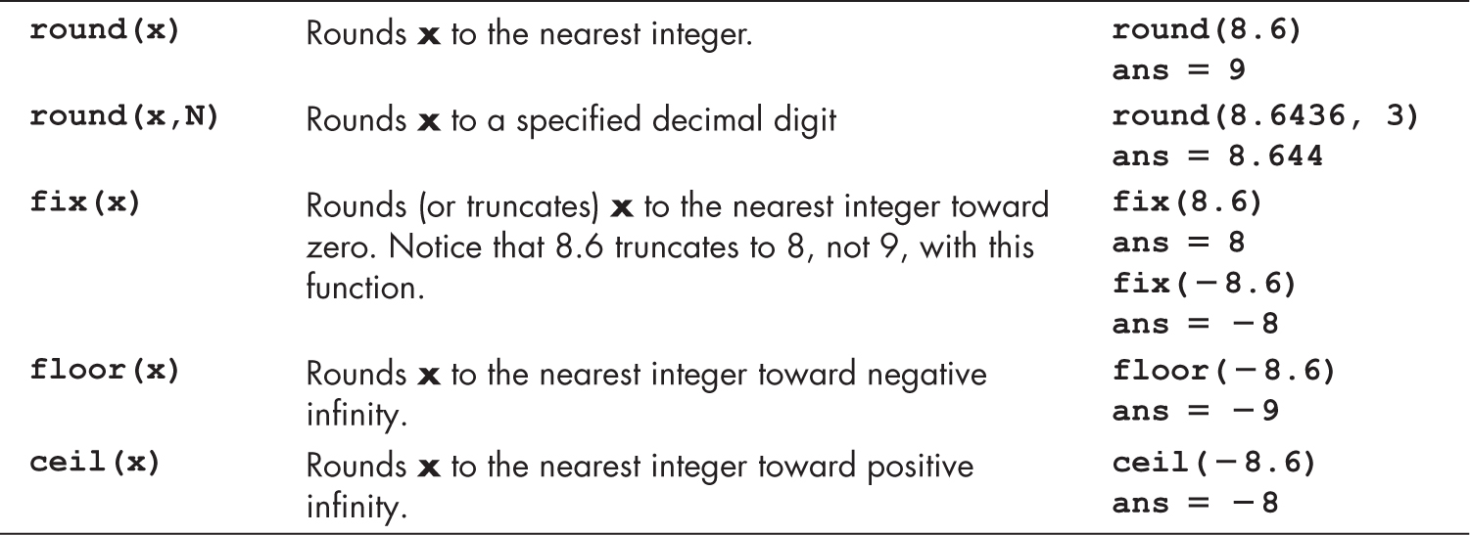
Rounding Functions
Truncates

Slide 3
Example: Rounding Functions
-0.6
-0.3
0.3
0.6
-1
0
1
 | round | ceil | fix | floor
0.3 | 0 | 1 | 0 | 0
0.6 | 1 | 1 | 0 | 0
-0.3 | 0 | 0 | 0 | -1
-0.6 | -1 | 0 | 0 | -1

Slide 4
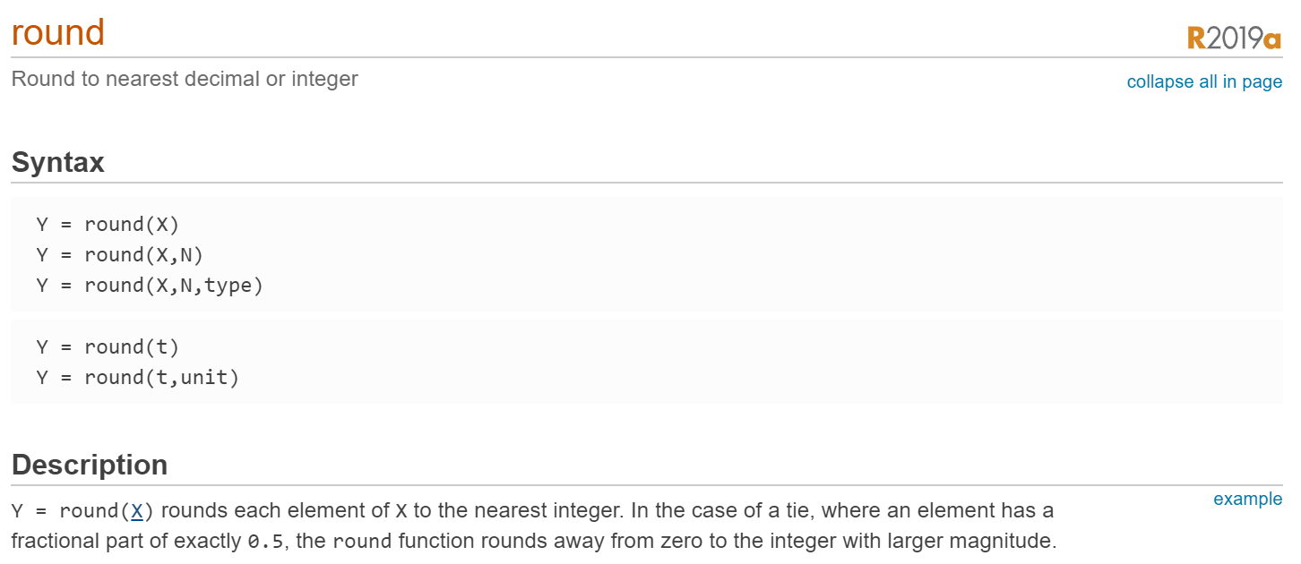
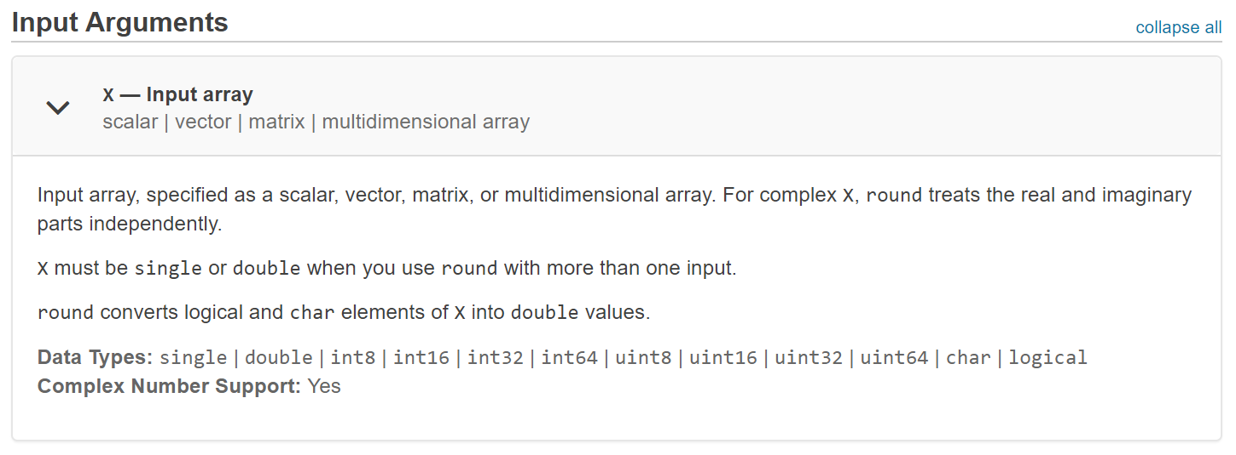
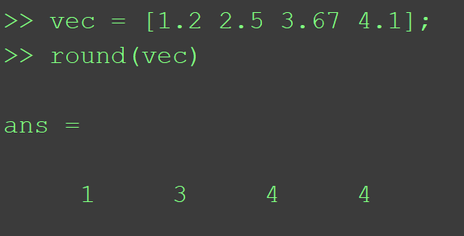
‘Round’ in MATLAB
https://www.mathworks.com/help/matlab/ref/round.html#buftmpz-X

Slide 5
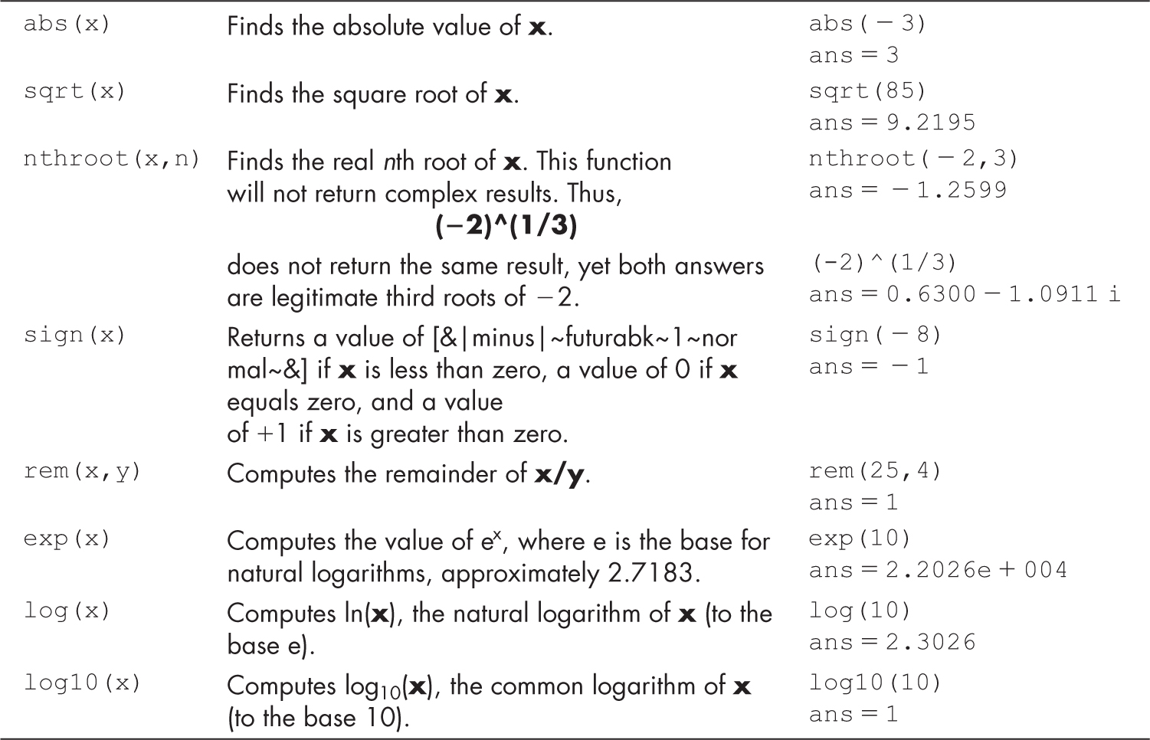
Common Math Functions
Return –1 is x is less than zero, a value of 0 if x equals zero, and a value of +1 if x is greater than zero

Slide 6
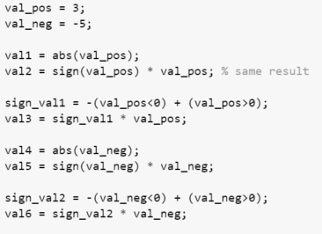
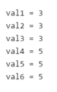
Example: Common Math Functions

Slide 7
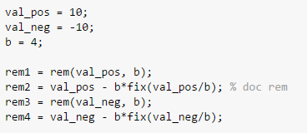
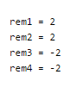
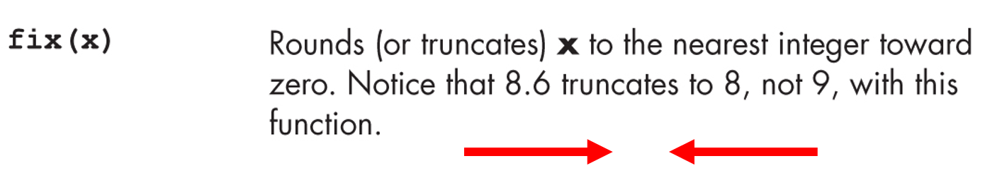
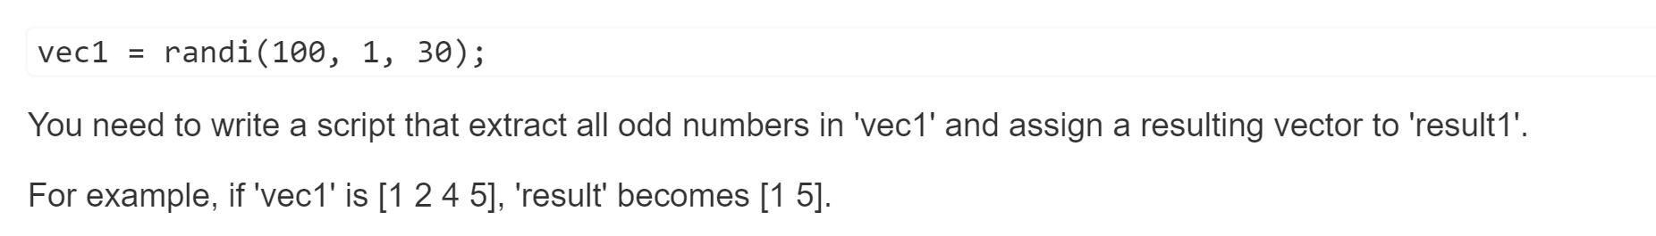
Example: Common Math Functions (Continue)
2.5
Quiz

Slide 8
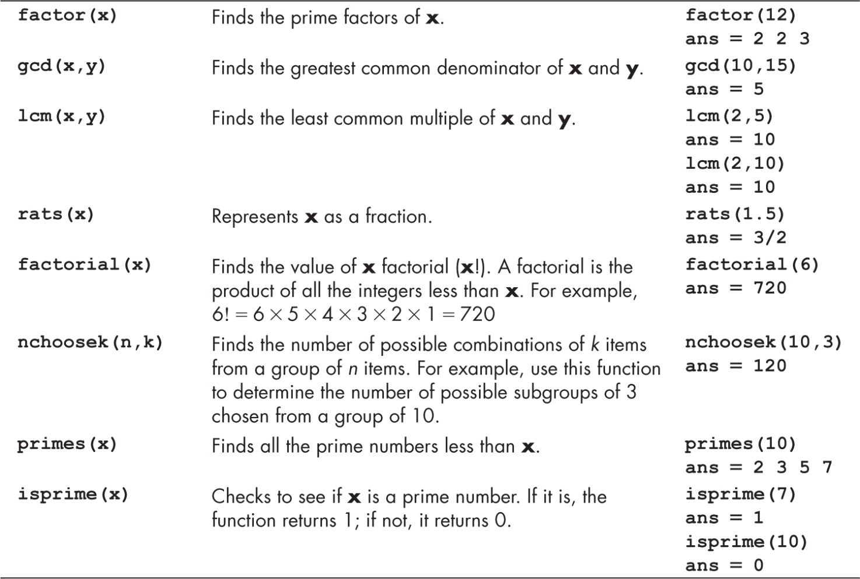
Function Used in Discrete Mathematics

Slide 9
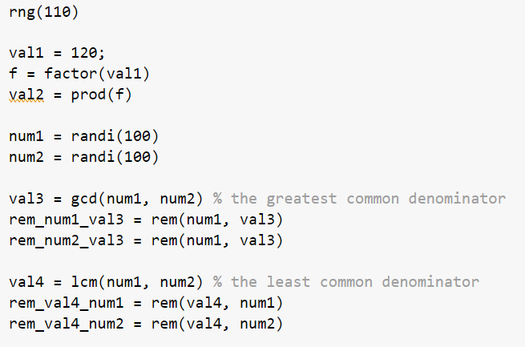
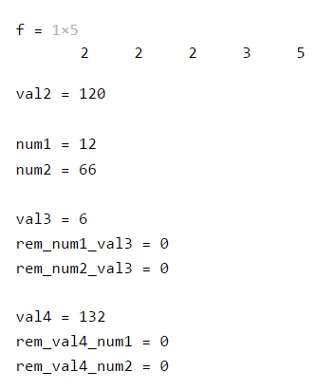
Example: Function Used in Discrete Mathematics

Slide 10
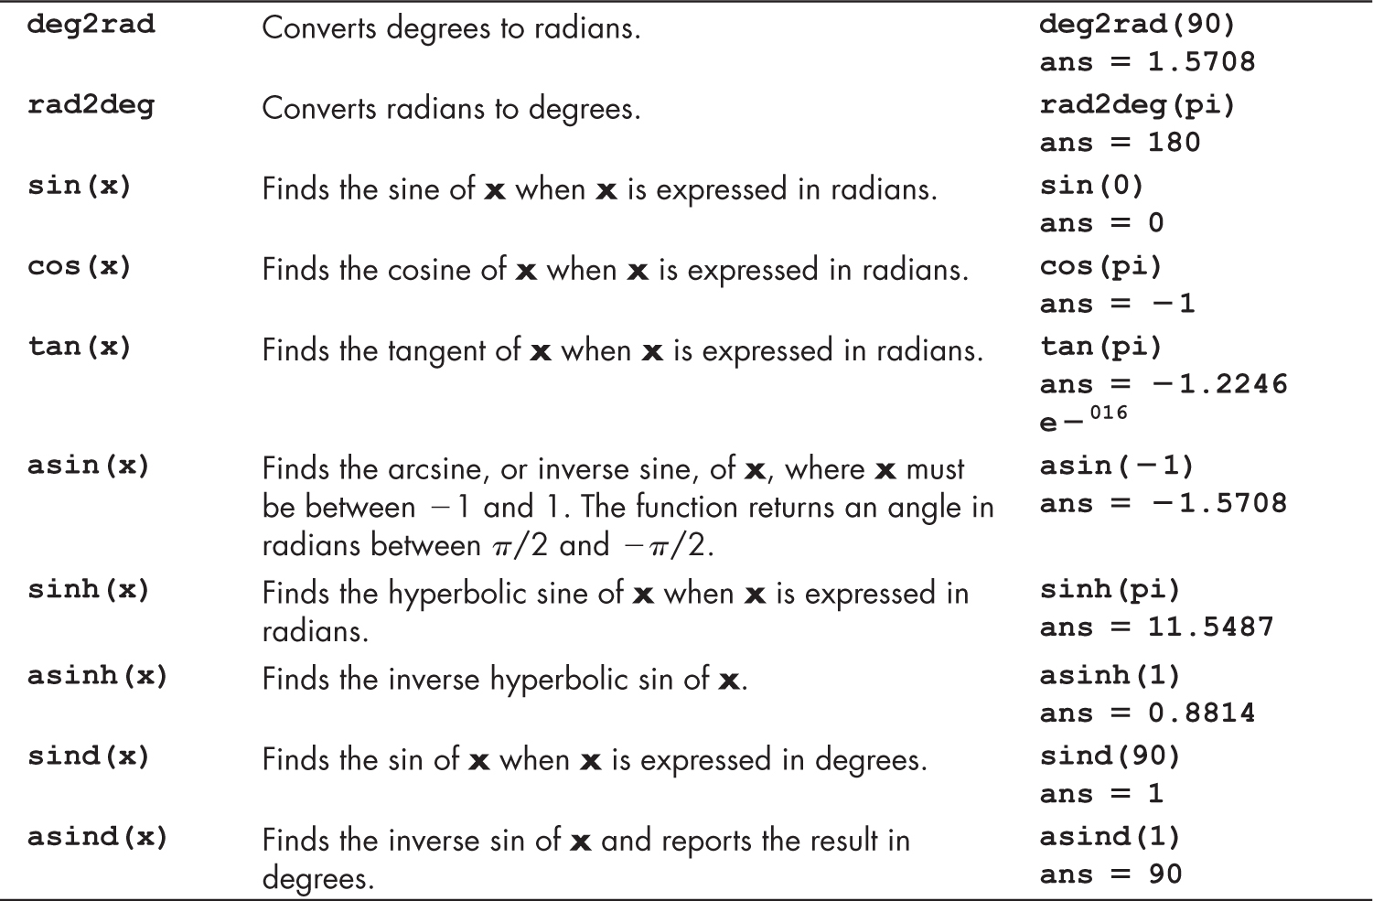
Some of the Available Trigonometric Functions

Slide 11
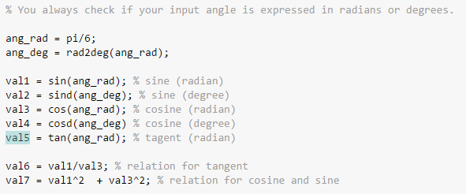
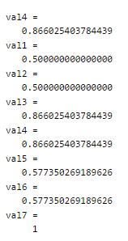
Example: Trigonometric Functions

Slide 12
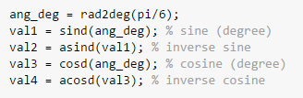
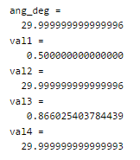
Example: Trigonometric Functions (Continue)
Why isn’t 30 degrees?
Pi is irrational and has infinite number of digits in its decimal representation
is_true = (ang_deg == 30)
not working
Please do not directly check the equality between numbers in double precision.
is_true = (round(ang_deg) == 30)
working
is_true = (ang_deg - 30) < 10^-5;
recommendation

Slide 13
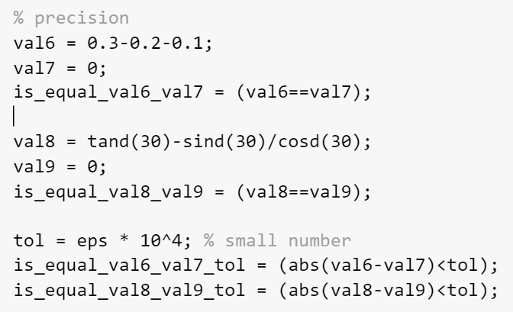
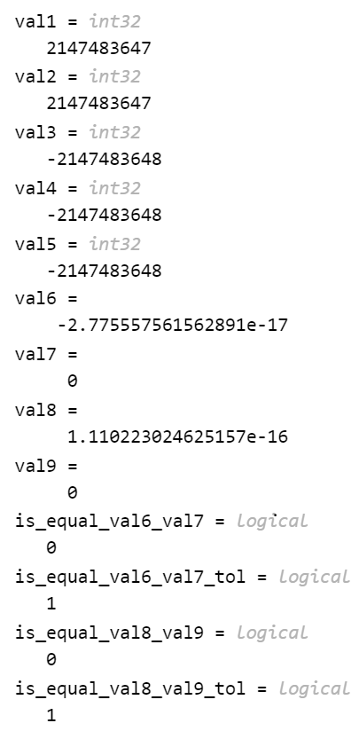
Example: Computational Limit
Recommendation: Do not use ‘==‘ when you compare numbers in a double precision

Slide 14
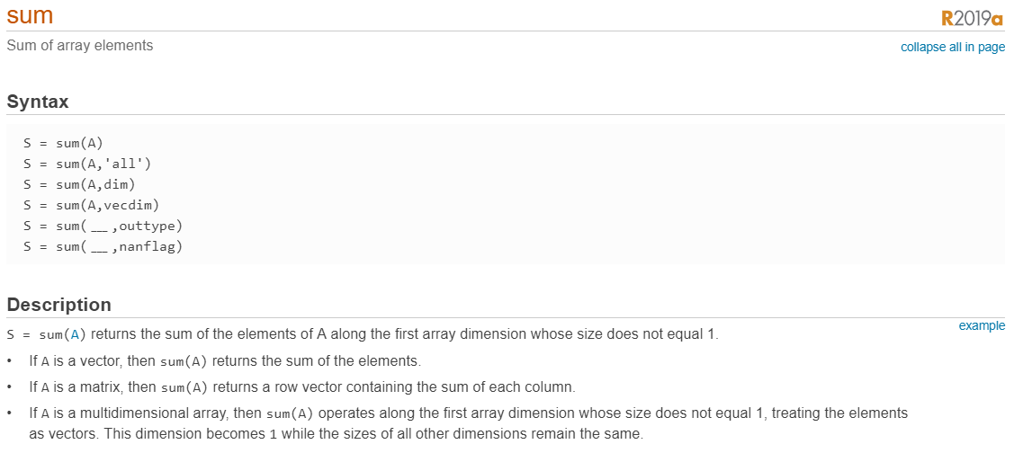
Sum in MATLAB

Slide 15
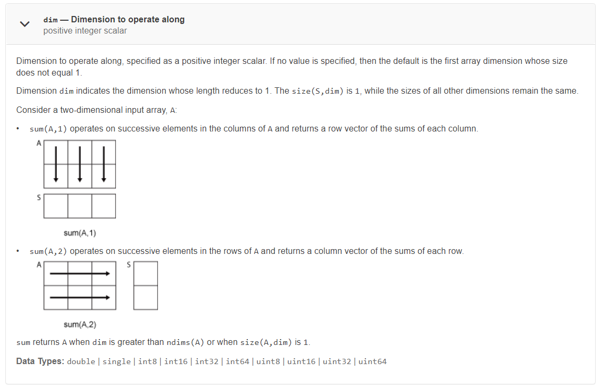
Sum in MATLAB (Continue)
1 | 2 | 3
4 | 5 | 6
7 | 8 | 9
12 | 15 | 18
1 | 2 | 3
4 | 5 | 6
7 | 8 | 9
6
15
24

Slide 16
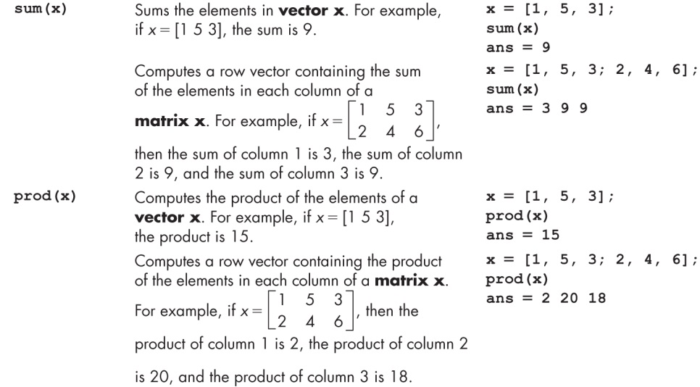
Sums and Products

Slide 17
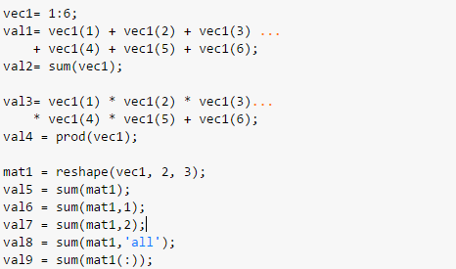
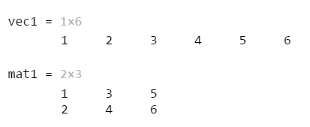
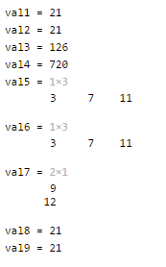
Example: Sum and Product
1 | 3 | 5
2 | 4 | 6

Slide 18
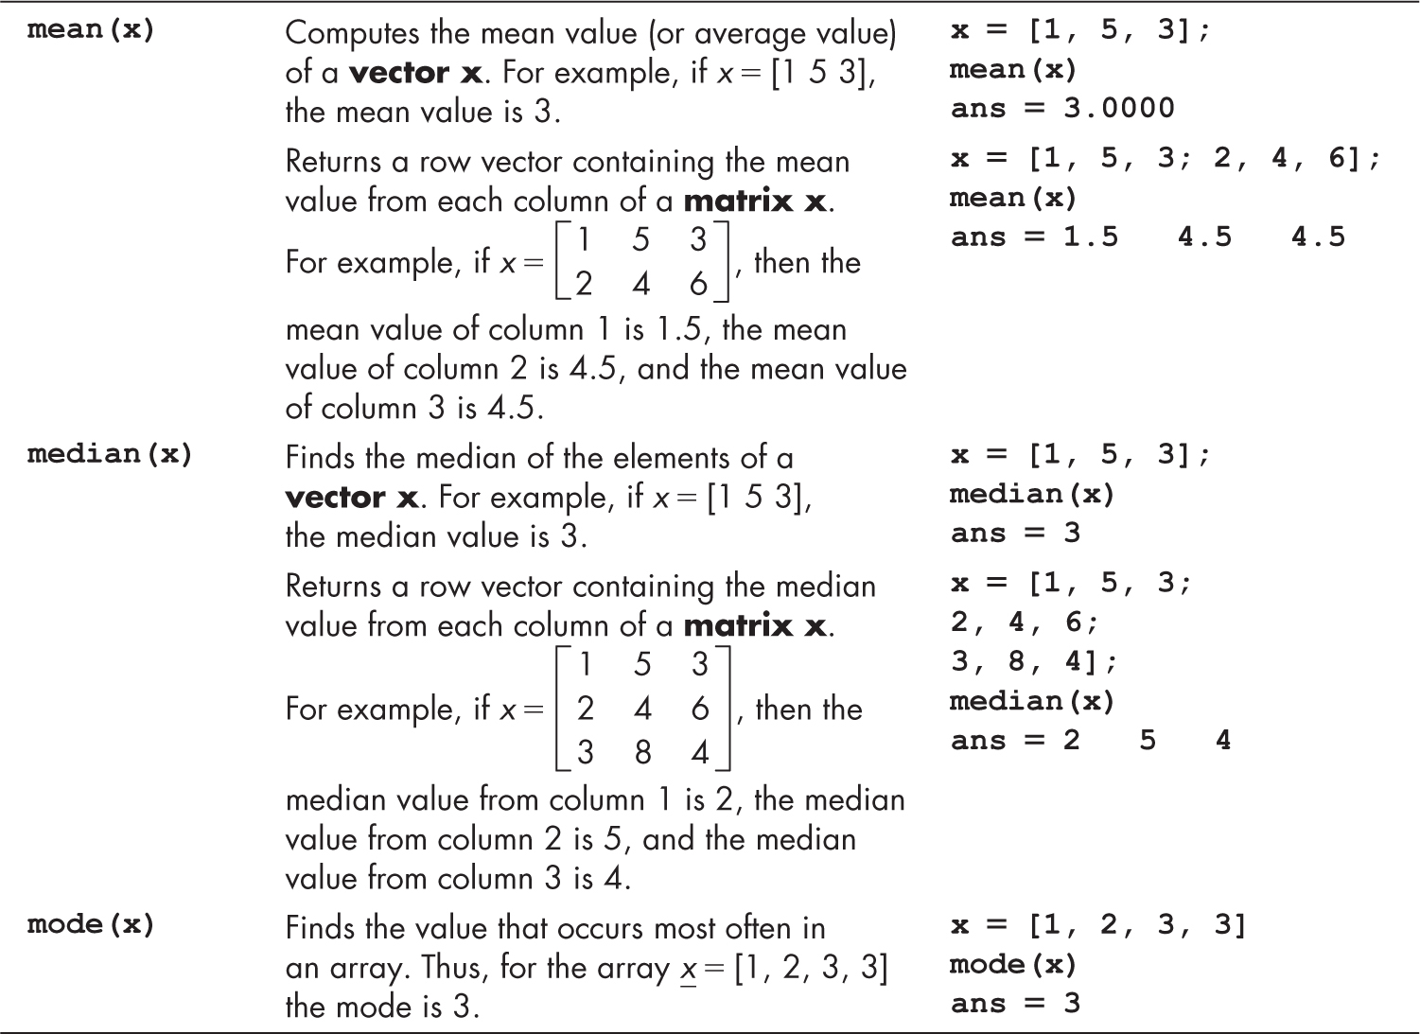
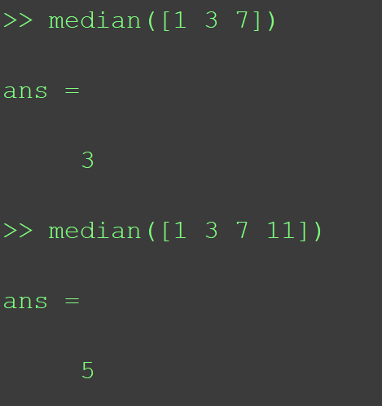
Averages

Slide 19
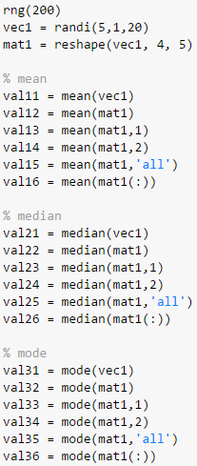
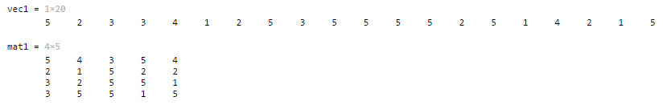
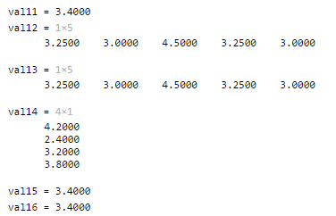
Example: Averages
5 | 4 | 3 | 5 | 4
2 | 1 | 5 | 2 | 2
3 | 2 | 5 | 5 | 1
3 | 5 | 5 | 1 | 5

Slide 20
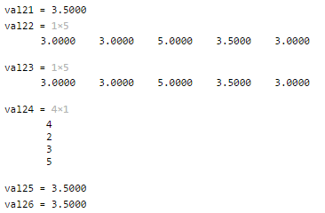
Example: Averages (Continue)
5 | 4 | 3 | 5 | 4
2 | 1 | 5 | 2 | 2
3 | 2 | 5 | 5 | 1
3 | 5 | 5 | 1 | 5

Slide 21
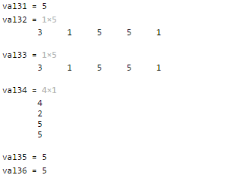
Example: Averages (Continue)
5 | 4 | 3 | 5 | 4
2 | 1 | 5 | 2 | 2
3 | 2 | 5 | 5 | 1
3 | 5 | 5 | 1 | 5

Slide 22
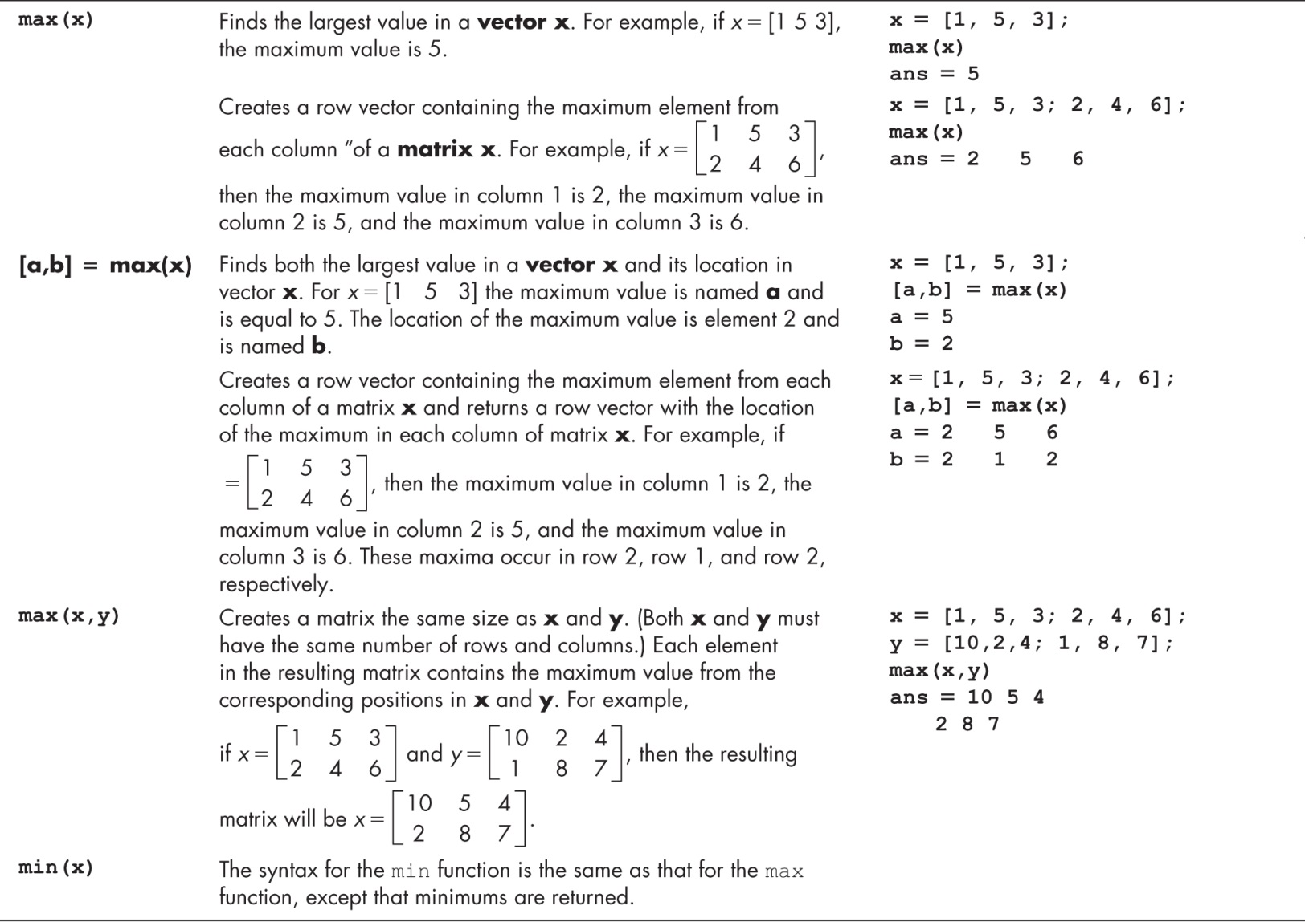
Maxima and Minima

Slide 23
Maxima and Minima (Continue)

Slide 24
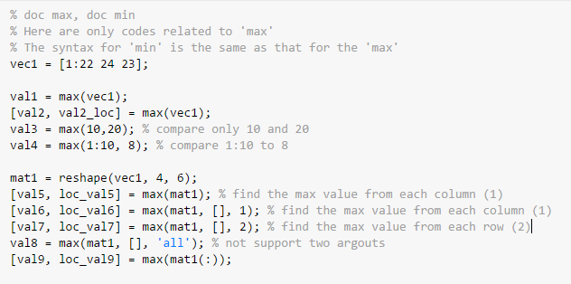
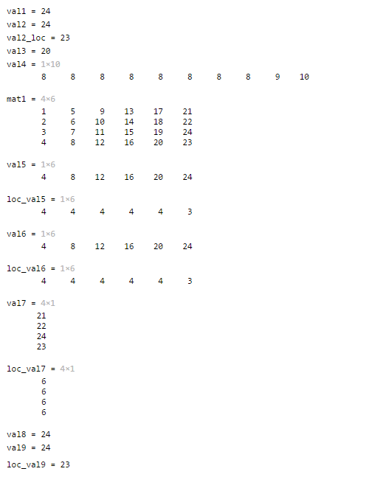
Example: Maxima and Minima

Slide 25
Example: Maxima and Minima (Continue)

Slide 26
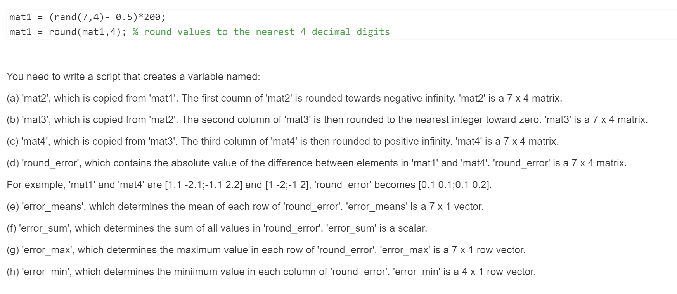
Quiz: Rounding Error Analysis

Slide 27
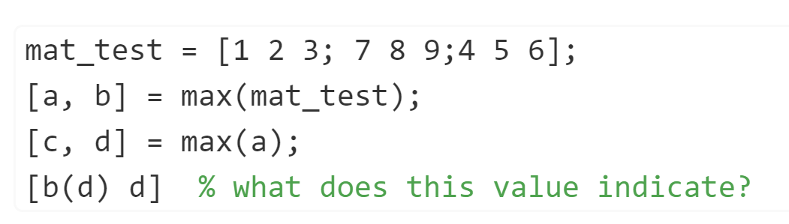
Question

Slide 28
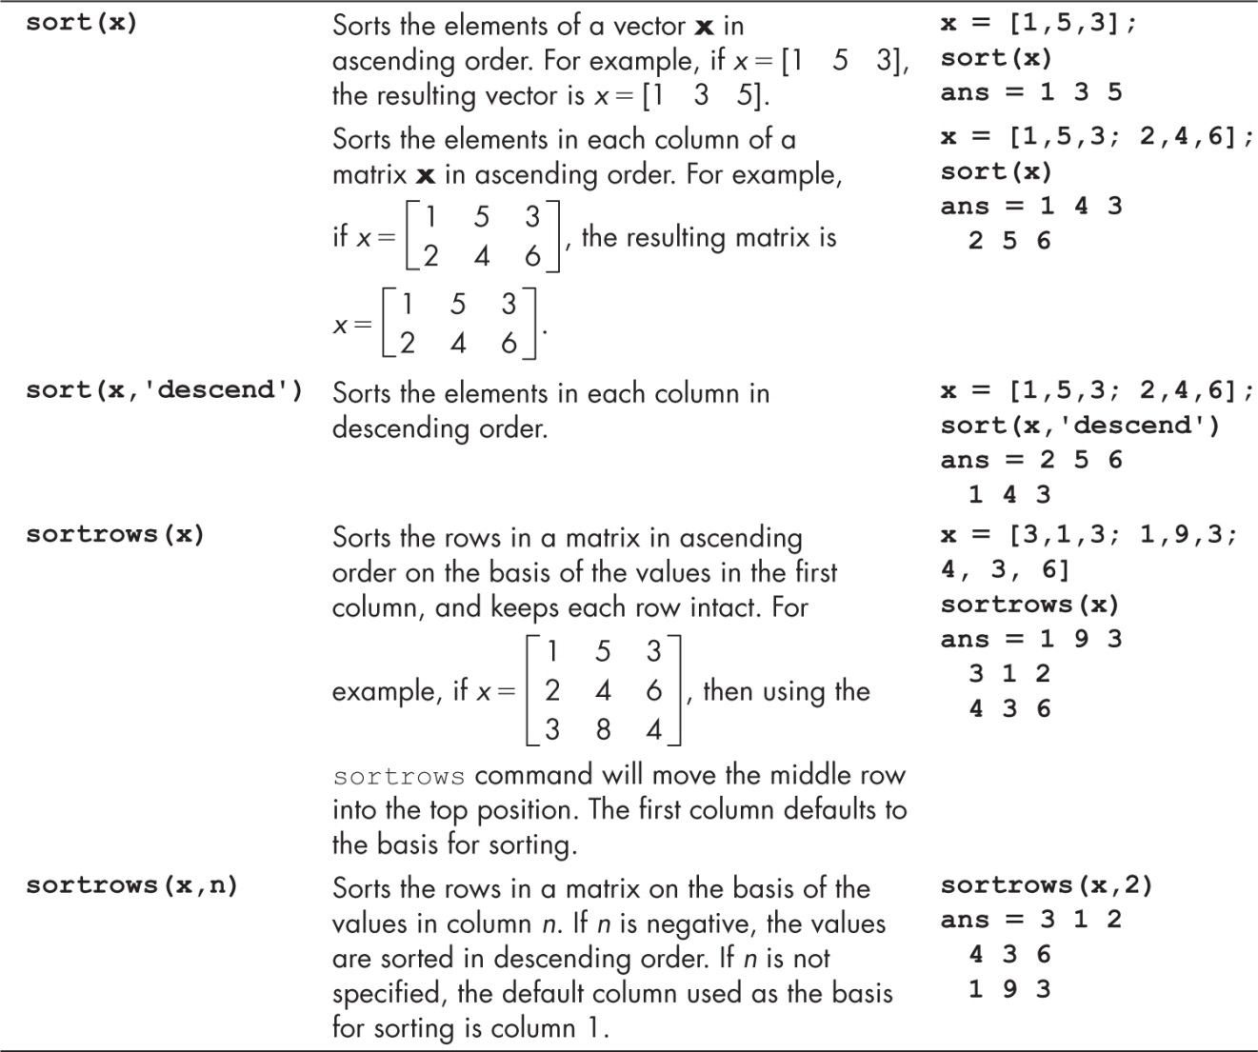
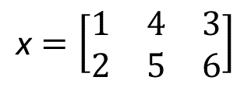
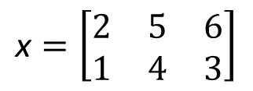
Sorting Functions
$$\text{x}=\left[\begin{matrix}1 & 4 & 3 \\ 2 & 5 & 6\end{matrix}\right]$$
First dimension => column
$$\text{x}=\left[\begin{matrix}2 & 5 & 6 \\ 1 & 4 & 3\end{matrix}\right]$$

Slide 29
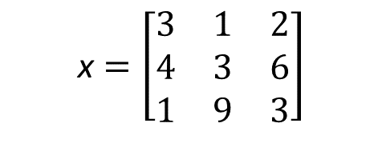
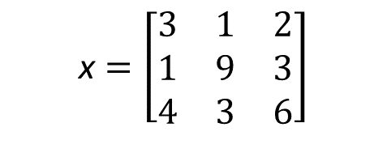
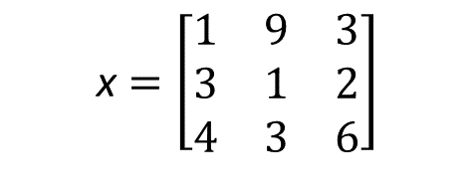

Sorting Functions (Continue)
2
$$\text{x}=\left[\begin{matrix}3 & 1 & 2 \\ 1 & 9 & 3 \\ 4 & 3 & 6\end{matrix}\right]$$
$$\text{x}=\left[\begin{matrix}1 & 9 & 3 \\ 3 & 1 & 2 \\ 4 & 3 & 6\end{matrix}\right]$$
$$\text{x}=\left[\begin{matrix}3 & 1 & 2 \\ 1 & 9 & 3 \\ 4 & 3 & 6\end{matrix}\right]$$
$$\text{x}=\left[\begin{matrix}3 & 1 & 2 \\ 4 & 3 & 6 \\ 1 & 9 & 3\end{matrix}\right]$$

Slide 30
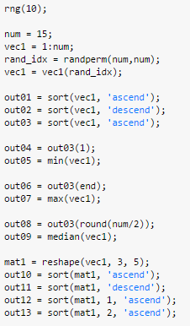
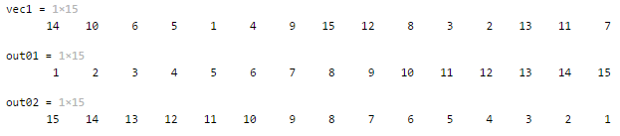
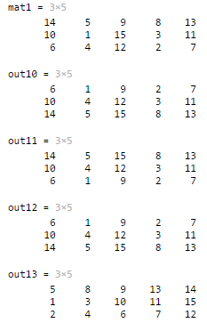
Example: sort

Slide 31
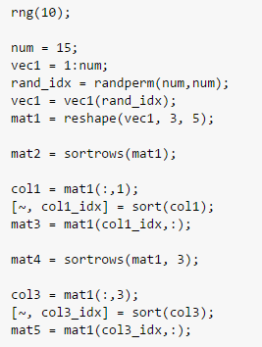
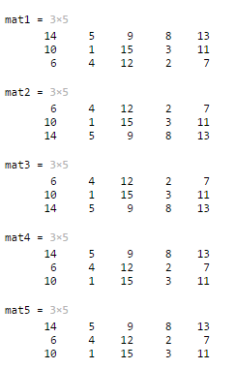
Example: sortrows

Slide 32

Quiz: Bulls and Cows
Bulls and Cows is a mind game played by two players. In the game, a random, 4-digit number is chosen and it's values are compared to those of another trial number. All four digits of the number are different. If any digit in the chosen number is the exact same value and in the exact same position as any digit in the trial number, this is called a bull. If the digit is present in both the trial number and chosen number, but is not in the same location, this is called a cow.

Slide 33



Quiz: Bulls and Cows (Continue)

Slide 34

Functions Used with Complex Numbers

Slide 35
Functions Used with Complex Numbers (Continue)

Slide 36



Example: Complex Numbers

Slide 37
Example: Complex Numbers (Continue)

Slide 38

Computational Limits
eps : Floating-point relative accuracy
https://www.mathworks.com/matlabcentral/answers/57444-faq-why-is-0-3-0-2-0-1-not-equal-to-zero

Slide 39
Array Operations
reshape changes dimensions of a matrix to any matrix with the same number of elements
diag create diagonal matrix or get diagonal elements of matrix
rot90 rotates a matrix 90 degrees counter-clockwise
fliplr flips columns of a matrix from left to right
flipud flips rows of a matrix up to down
flip flips a row vector left to right, column vector or matrix up to down
repmat replicates an entire matrix; it creates m x n copies of the matrix
repelem replicates each element from a matrix in the dimensions specified

Slide 40


Example: Create and Index Arrays

Slide 41


Example: Combine and Transform Array (horcat, vertcat, cat)
[mat01 mat01]
[mat01; mat01]
Readability

Slide 42

Example: Cat
mat_g = zeros(n,n,2);
mat_g(:,:,1) = mat1;
mat_g(:,:,2) = mat2;
mat_g = cat(3, mat1, mat2)

Slide 43

Example: Combine and Transform Array (repelem)
repelem replicates each element from a matrix in the dimensions specified
1 | 1
1 | 1
2 | 2
2 | 2
1 | 1
1 | 1
2 | 2
2 | 2
1 | 1
1 | 1
2 | 2
2 | 2
1 | 1
1 | 1
2 | 2
2 | 2
3 | 3
3 | 3
4 | 4
4 | 4
3 | 3
3 | 3
4 | 4
4 | 4
1 | 1
1 | 1
2 | 2
2 | 2
1 | 2
3 | 4
3 | 3
3 | 3
4 | 4
4 | 4

Slide 44
Example: Combine and Transform Array

Slide 45

Quiz: Create Matrices

Slide 46
Quiz: Create Matrices (Hint)
1 | 0 | 0 | 0
0 | 1 | 0 | 0
0 | 0 | 1 | 0
0 | 0 | 0 | 1
eye(4,4)
1 | 1 | 0 | 0
1 | 1 | 0 | 0
0 | 0 | 1 | 1
0 | 0 | 1 | 1
0 | 0 | 0 | 0
0 | 0 | 0 | 0
0 | 0 | 0 | 0
0 | 0 | 0 | 0
repelem(eye(4,4), 2,2)
0 | 0 | 0 | 0
0 | 0 | 0 | 0
0 | 0 | 0 | 0
0 | 0 | 0 | 0
1 | 1 | 0 | 0
1 | 1 | 0 | 0
0 | 0 | 1 | 1
0 | 0 | 1 | 1

Slide 47
Slide Credits and References
Stormy Attaway, 2018, Matlab: A Practical Introduction to Programming and Problem Solving, 5th edition
Lecture slides for “Matlab: A Practical Introduction to Programming and Problem Solving”
Holly Moore, 2018, MATLAB for Engineers, 5th edition

Slide 48


Example: factor(x), gcd(x,y), and lcm(x,y)

Slide 49



Example: factorial(x) and nchoosek(n,k)

